Slide 1

Introduction to R

Slide 2
What is R
History of R
What is R language used for
features of R language
Why R
Applications of R
Installtion

Slide 3
What is R Programming Language
R is an open-source programming language that is widely used as a statistical software and data analysis tool.

Slide 4
A (Brief) History of R
R is an extension of the S-programming language
R was created by Ross Ihaka and Robert Gentleman in the Department of Statistics at the University of Auckland.
1992: R development begins as a research project in Auckland, NZ
2000: R 1.0.0 released (February 29)
2004: R 2.0.0 released
2013: R 3.0.0 released
2020: R 4.0.0 released

Slide 5
What is R used for?
Statistical inference
Data analysis
Data Visualization
Machine learning algorithm

Slide 6
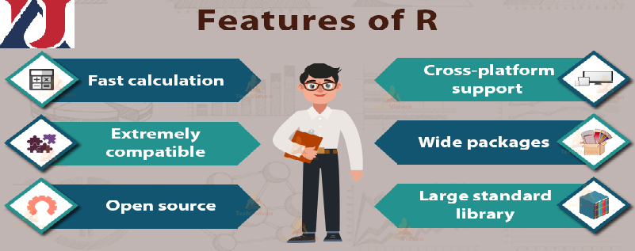

Slide 7
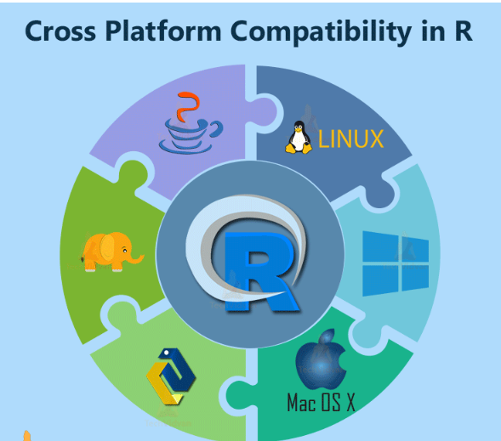

Slide 8
Features of R
free and open-source
cross-platform interoperability
Running Code Without a Compiler: (interpreted language)
Effectively associates different databases
provides a wide variety of packages(CRAN)
Data Variety

Slide 9
Unique Features of R Programming
Since R can perform operations directly on vectors, it doesn’t require too much looping.
R can pull data from APIs, servers, SPSS files, and many other formats.
R is useful for web scraping.
It can perform multiple complex mathematical operations with a single command.
Using R Markdown, it can create attractive reports that combine plain text with code and visualizations of the results.
Due to a large number of researchers and statisticians using it, new ideas and technologies often appear in the R community first.

Slide 10
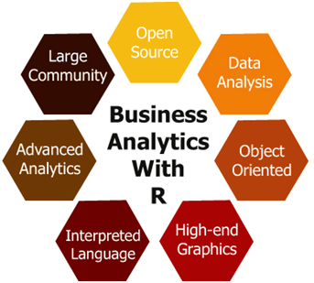
R Programming gives a broad variety of statistical

Slide 11
Why use R for statistical computing and graphics
R is open-source and free
Highly Active Community
Strong Graphical Capabilities
Comprehensive Environment
Can Perform Complex Statistical Calculations
Distributed Computing
Machine Learning
Data Wrangling
Generates Report in any Desired Format
Compatible with Other Programming Languages
Compatibility with Other Data Processing Technologies

Slide 12
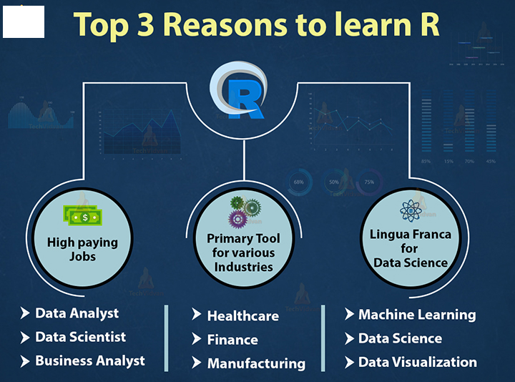

Why Learn R?

Slide 13
Alternatives to R programming
Python – Popular general purpose language
SAS (Statistical Analysis System)
SPSS – Software package for statistical analysis

Slide 14
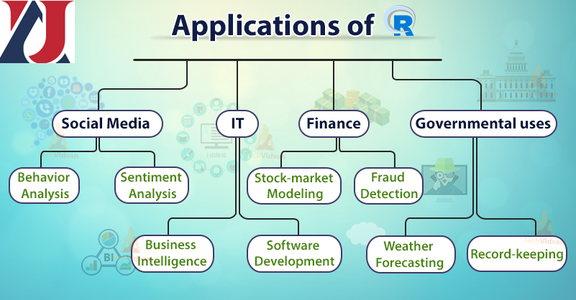

Slide 15
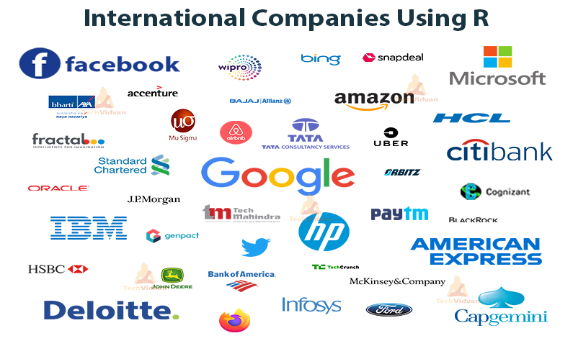

Slide 16
Installing R and Rstudio on Windows

Slide 17
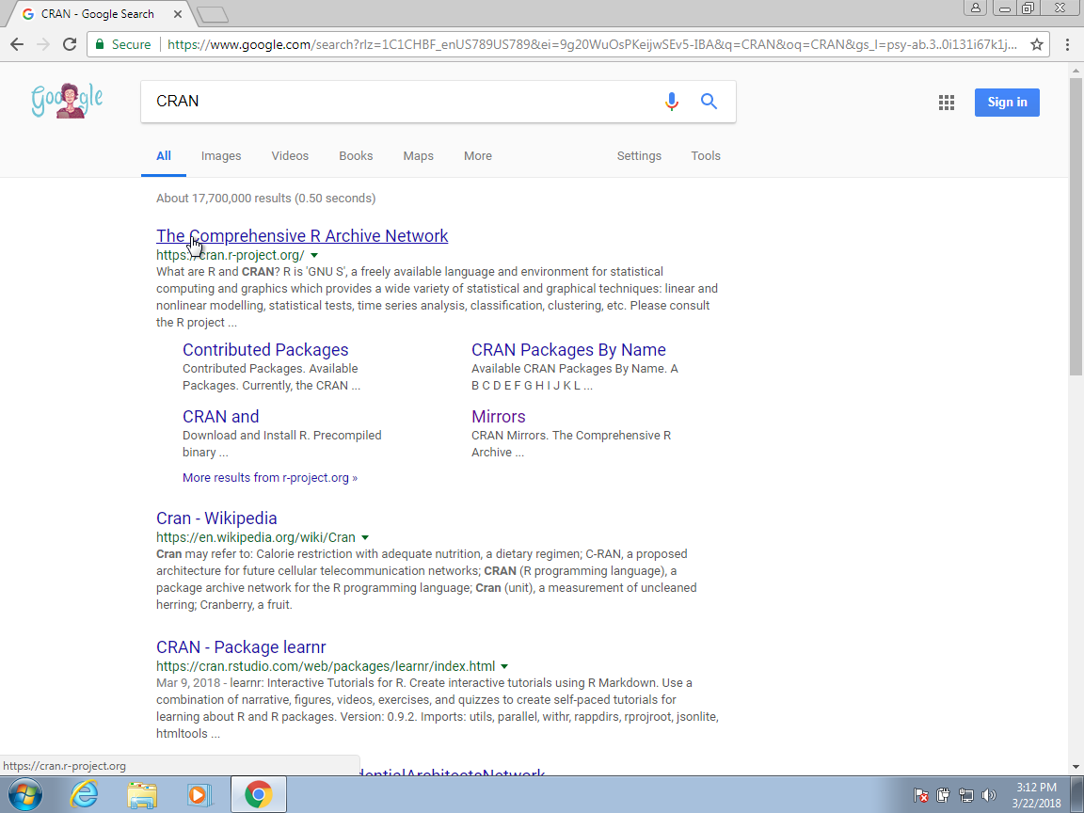
You can download R from the Comprehensive R Archive Network (CRAN). Search for CRAN on your browser:

Slide 18
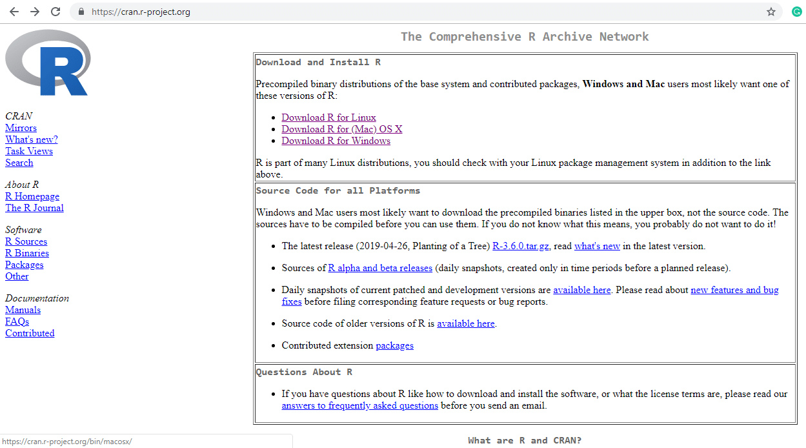
Step – 1: Go to CRAN R project website. https://cran.r-project.org/

Slide 19
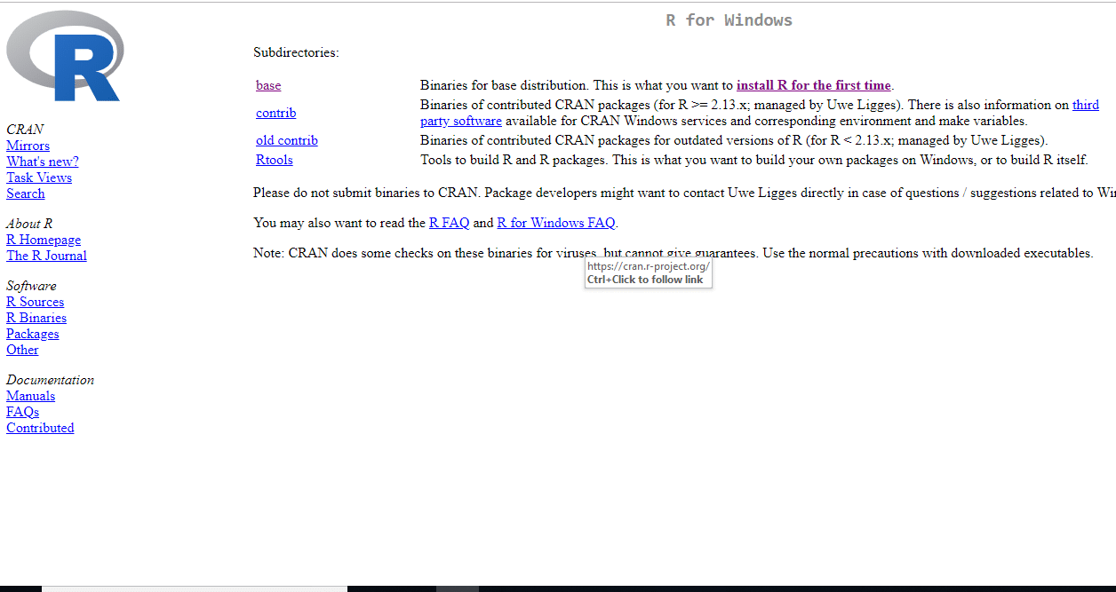
Step – 2: Click on the Download R for Windows link.

Slide 20
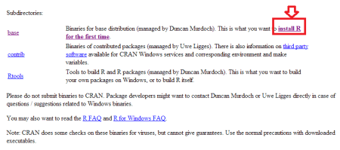
Step – 3: Click on the base subdirectory link or install R for the first time link.

Slide 21
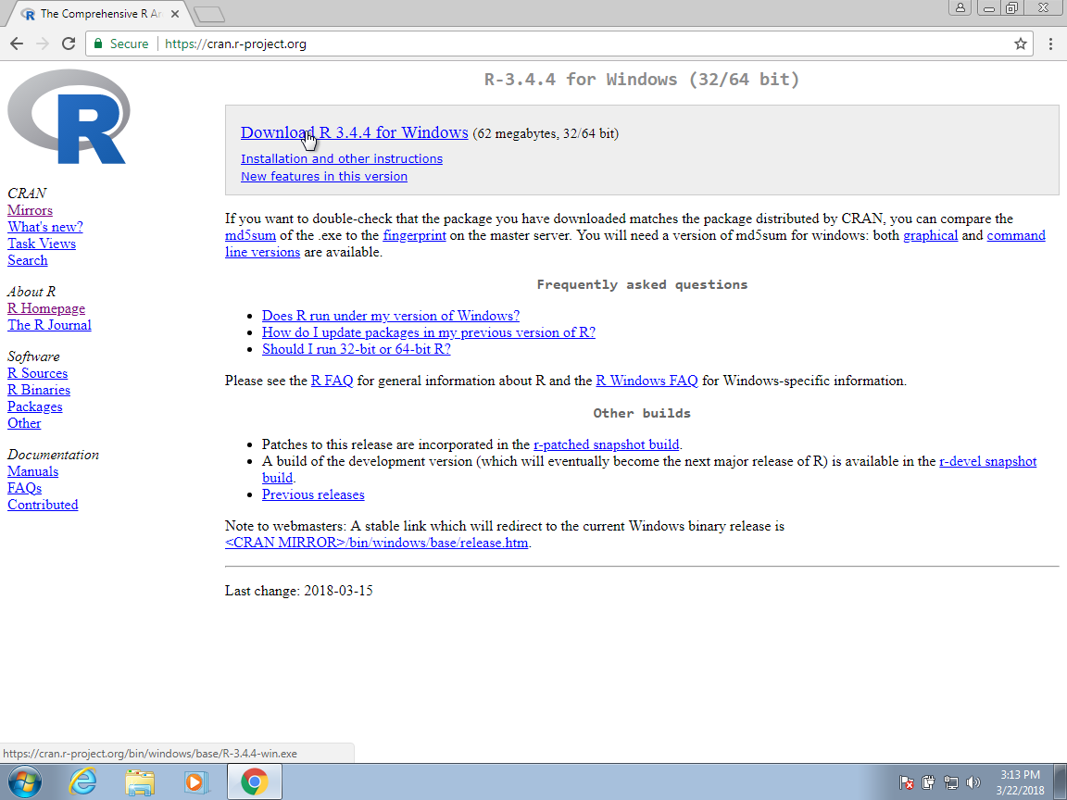
Step – 4: Click Download R X.X.X for Windows (X.X.X stand for the latest version of R. eg: 3.6.1) and save the executable .exe file.

Slide 22
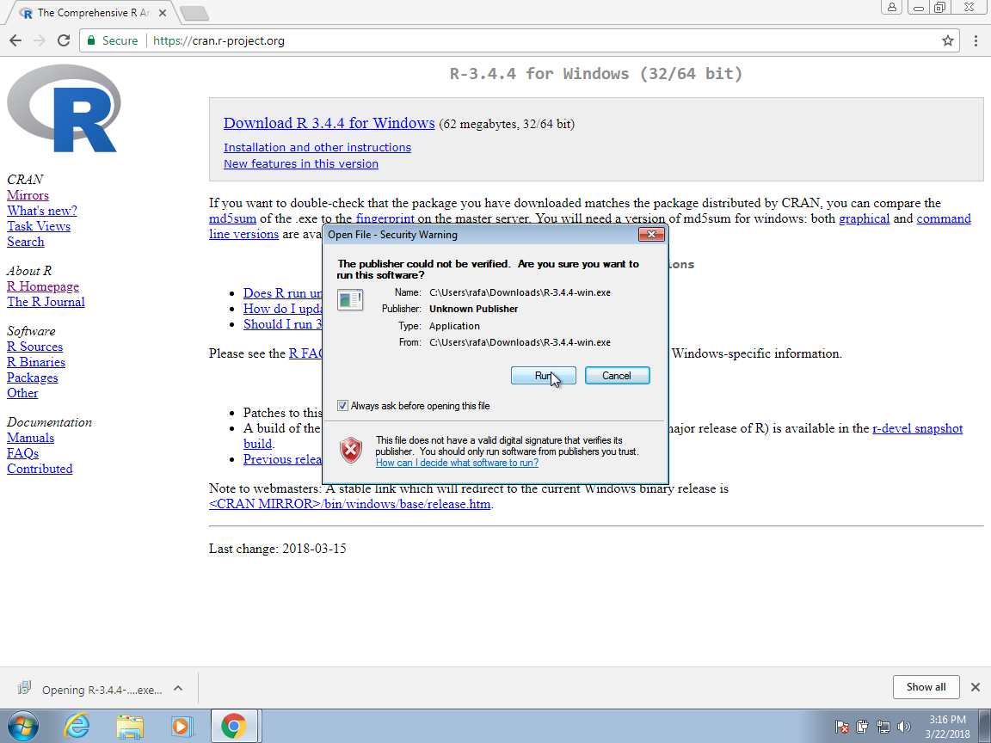

Slide 23
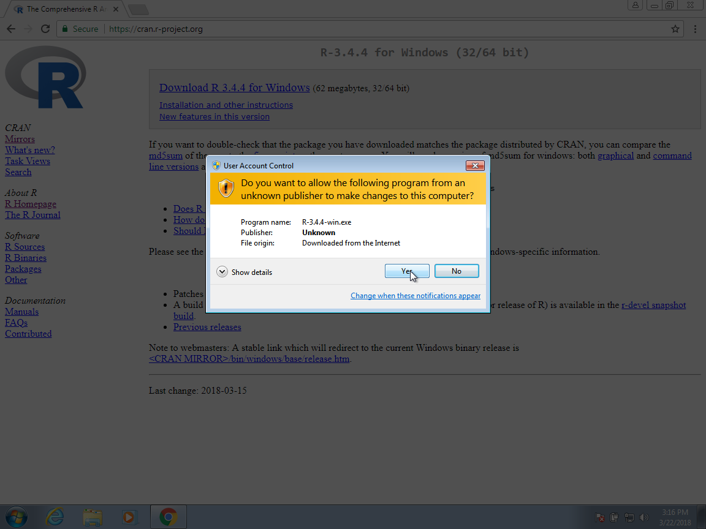

Slide 24
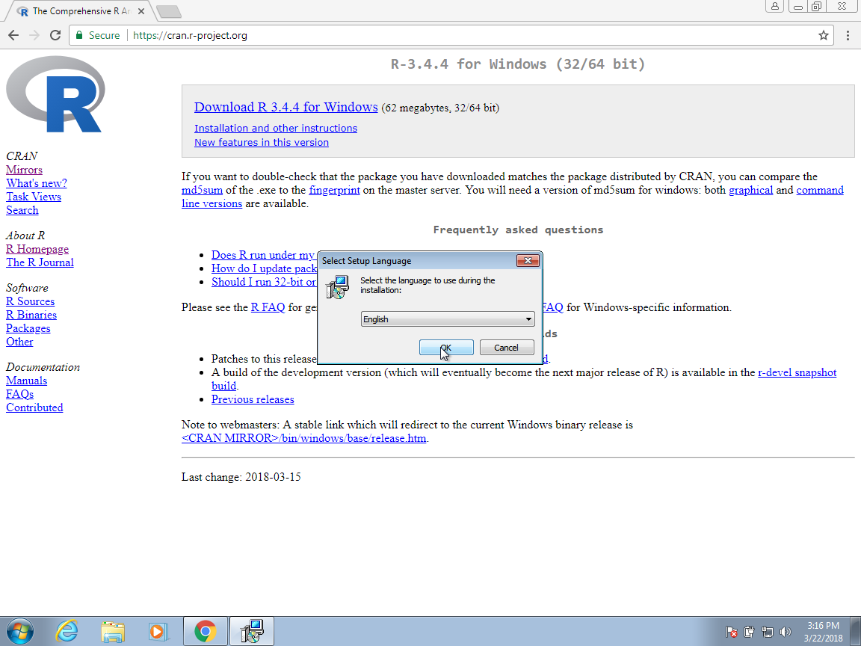

Slide 25
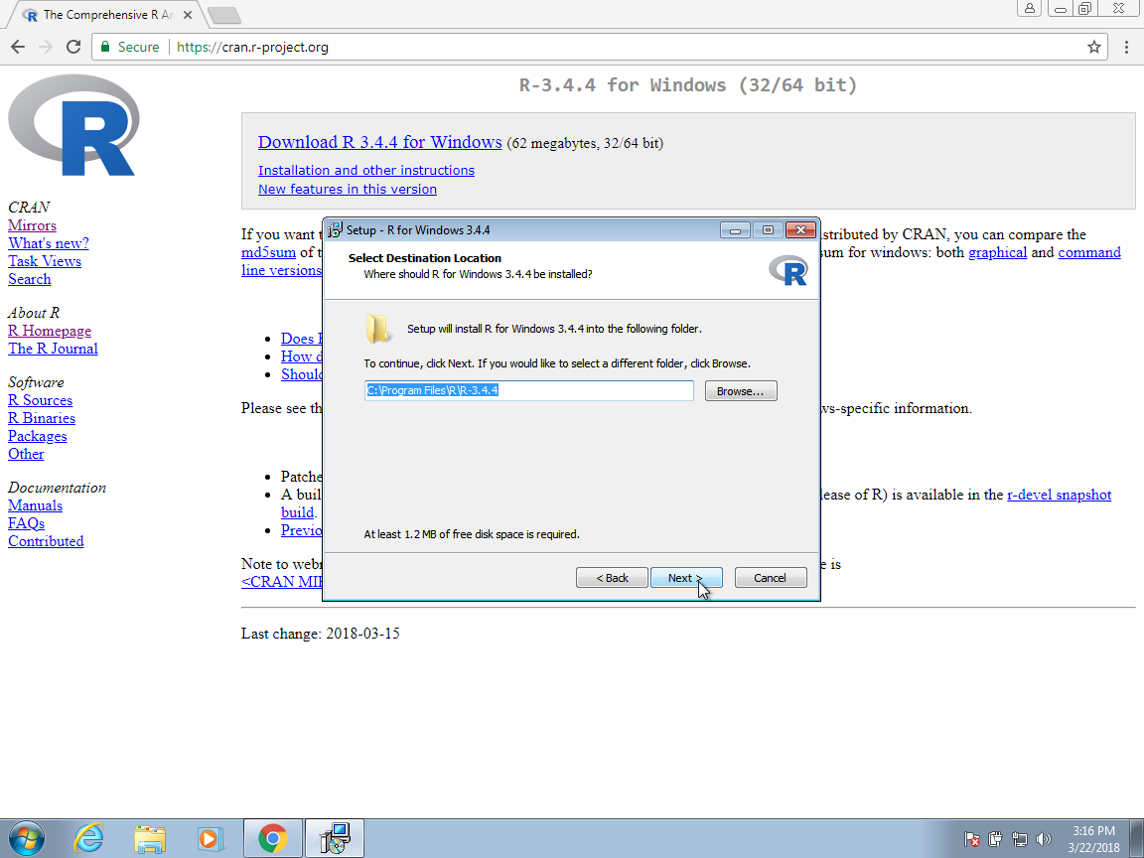

Slide 26
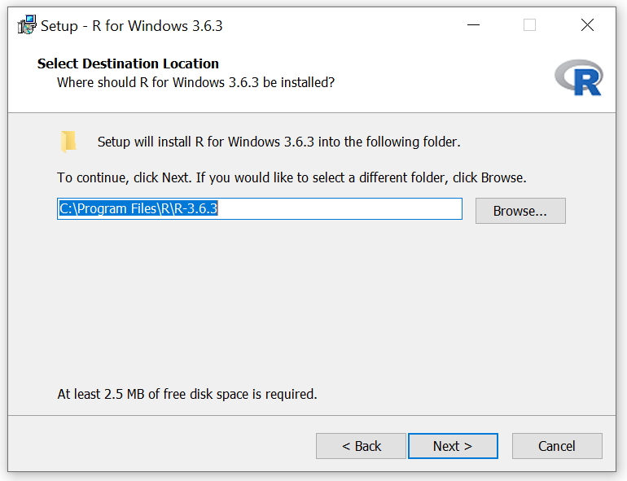

Slide 27
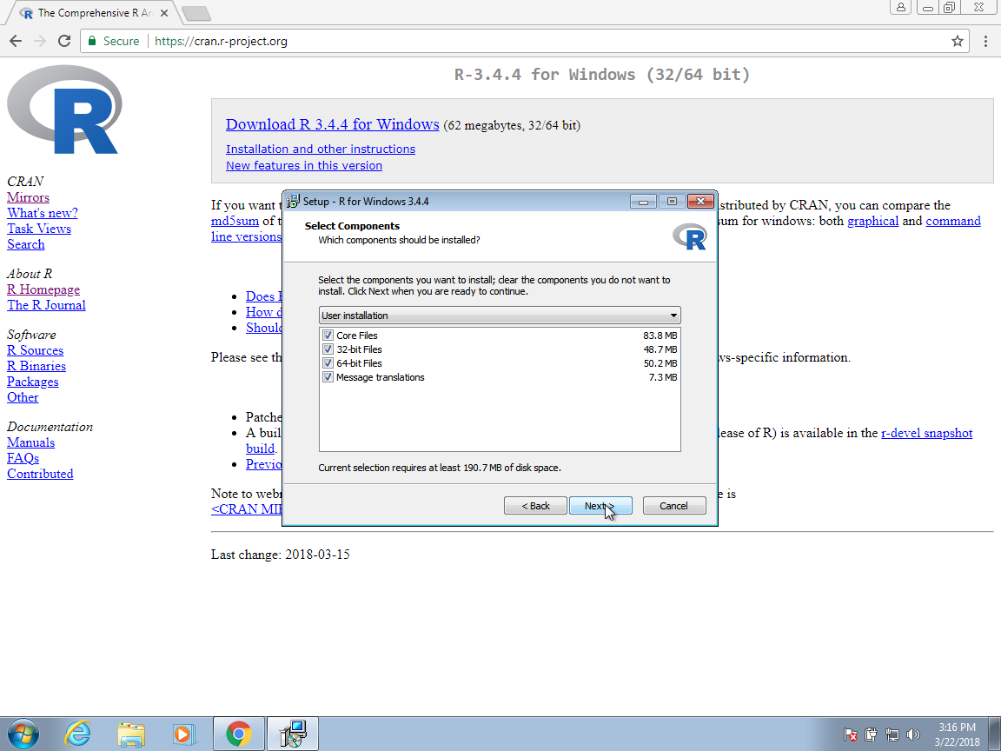

Slide 28
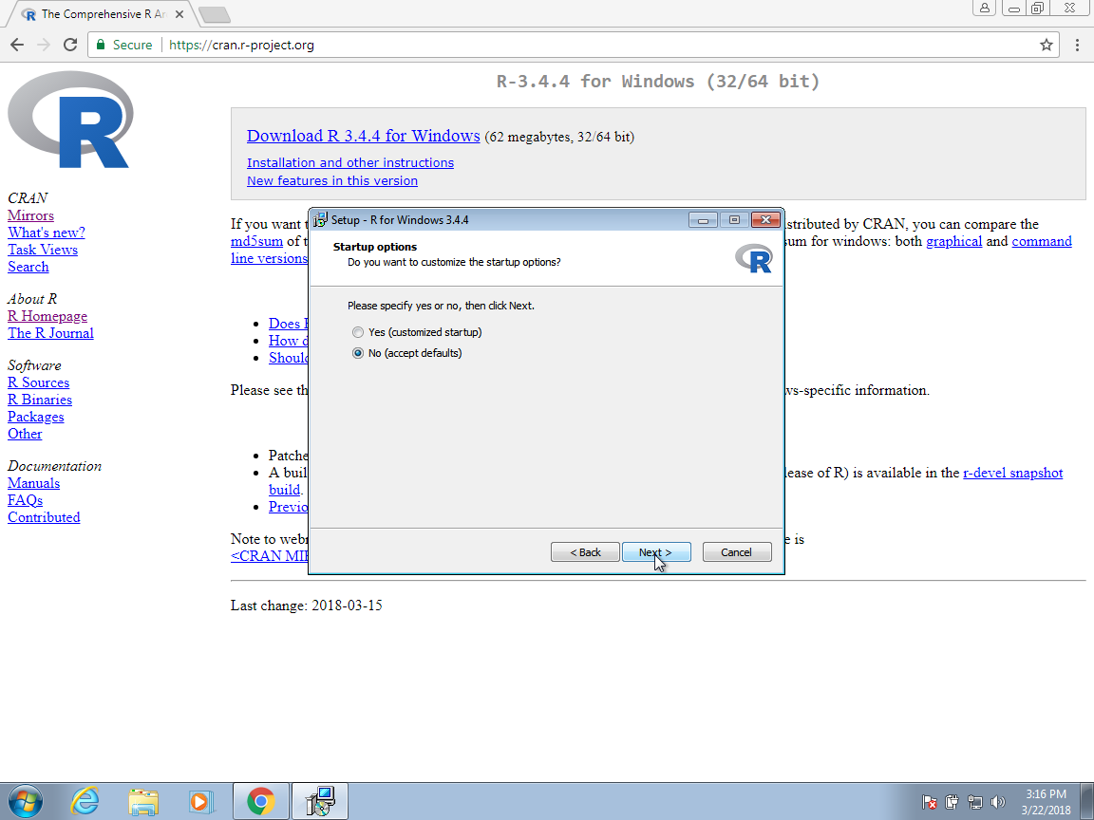

Slide 29
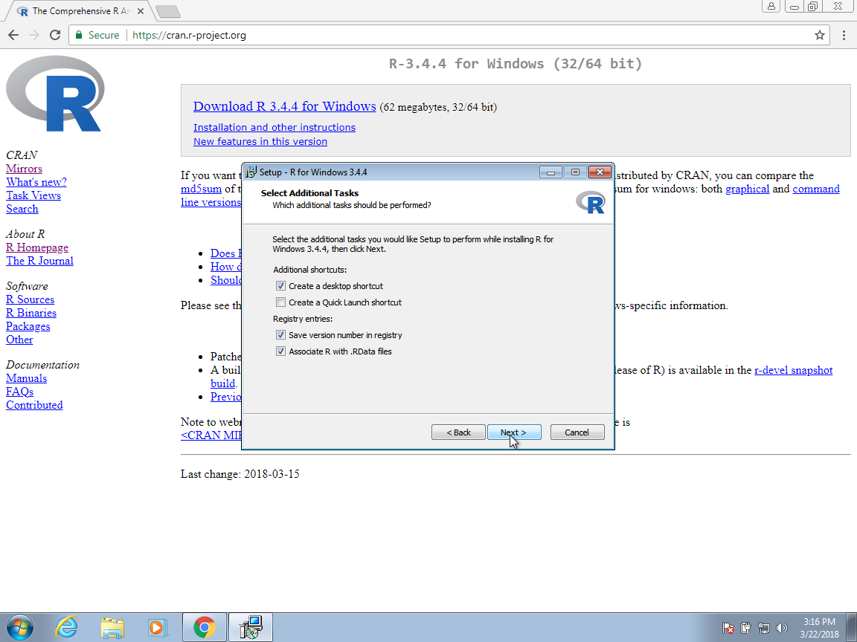

Slide 30
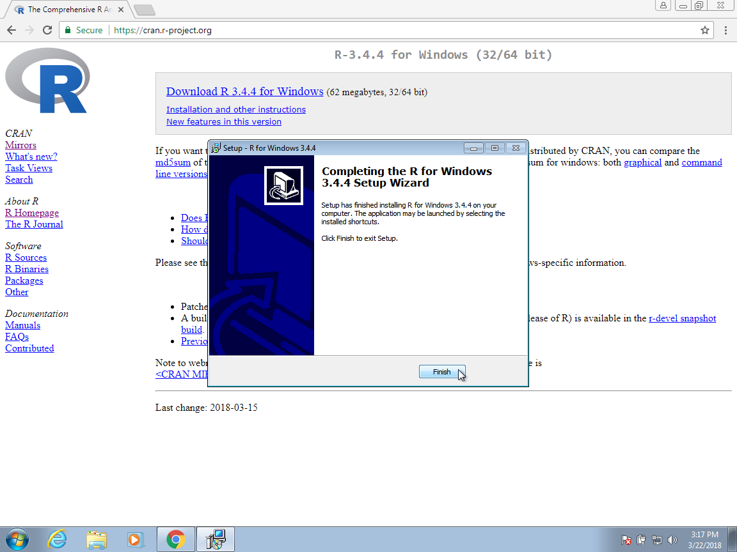

Slide 31
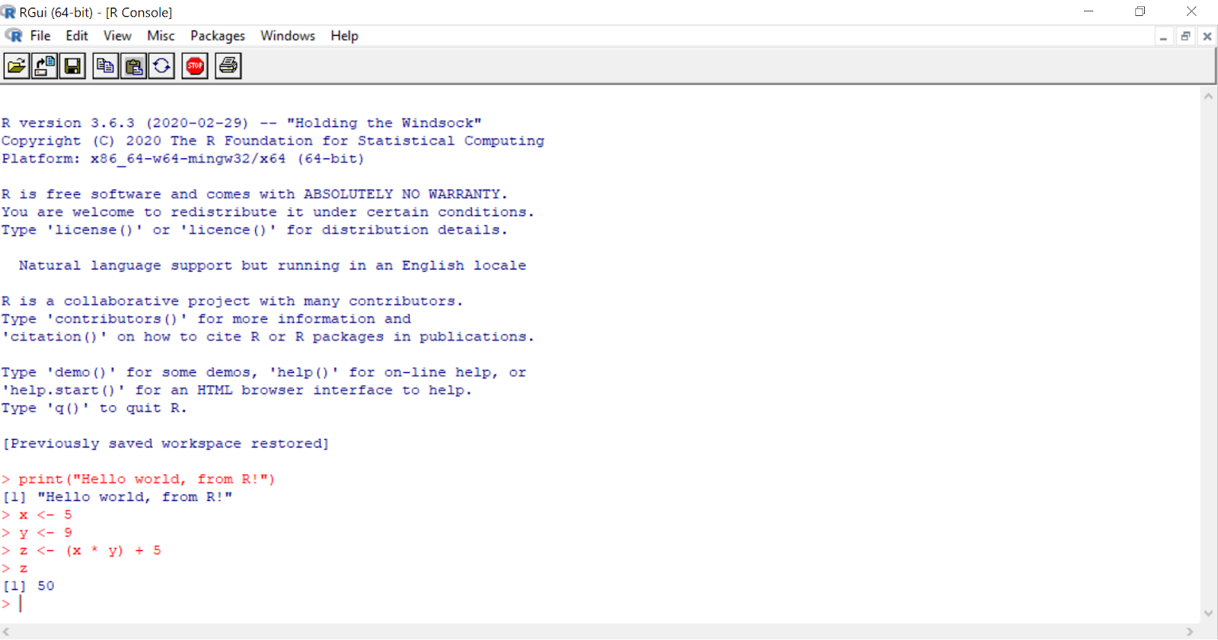

Slide 32
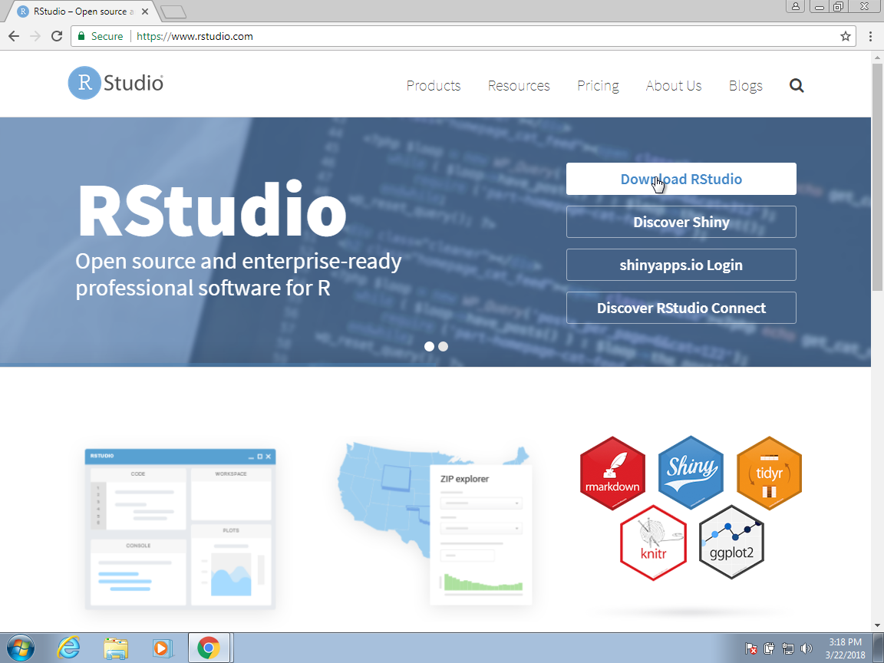
Install RStudio
Step 1: To download R Studio, first Go to the official R Studio website by clicking this link Download.

Slide 33
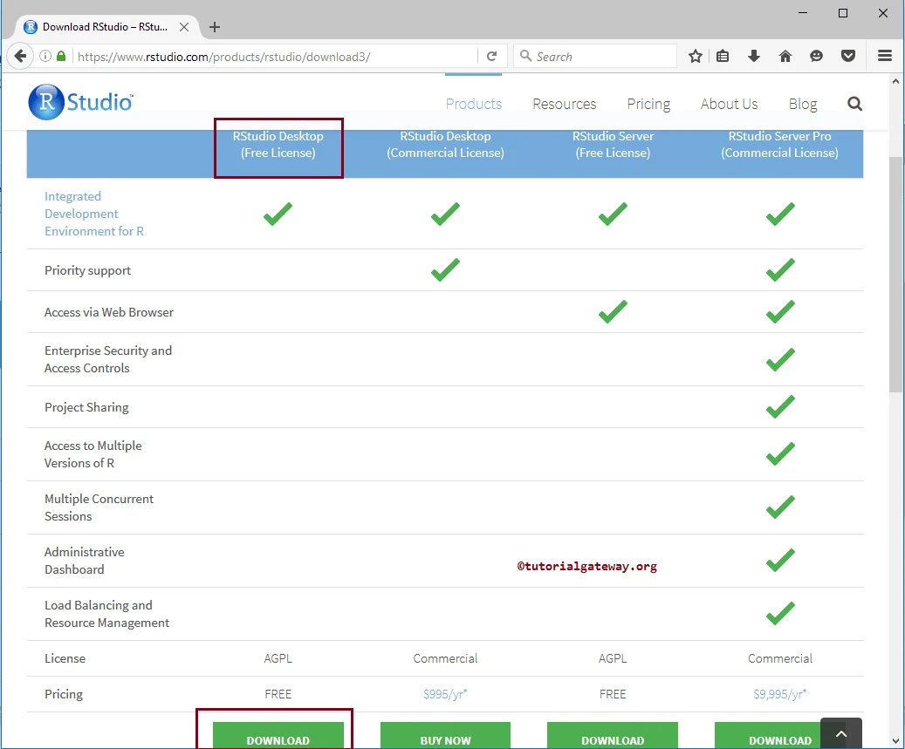

Slide 34
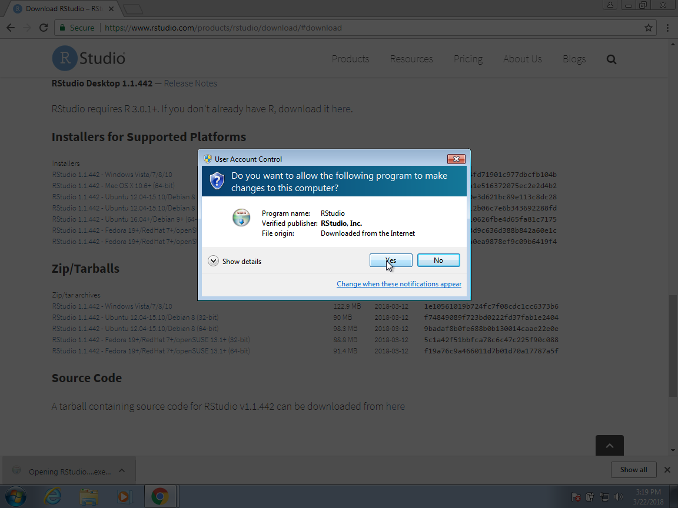

Slide 35
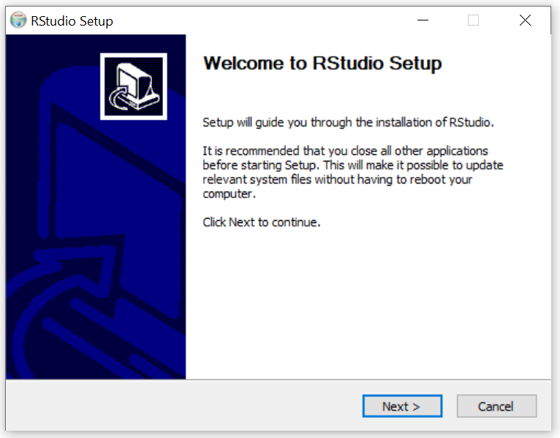

Slide 36
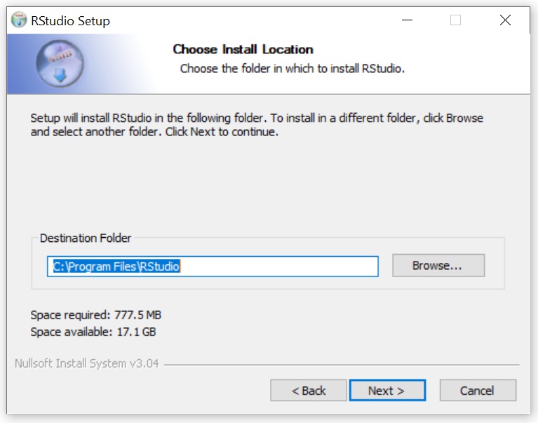

Slide 37
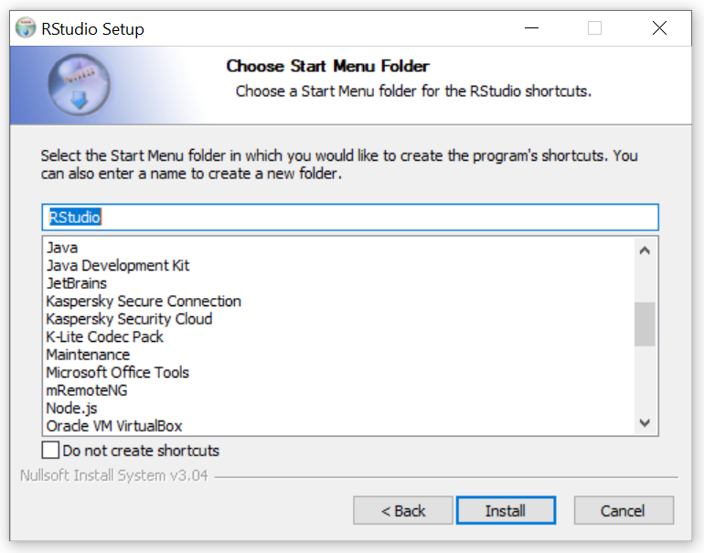

Slide 38
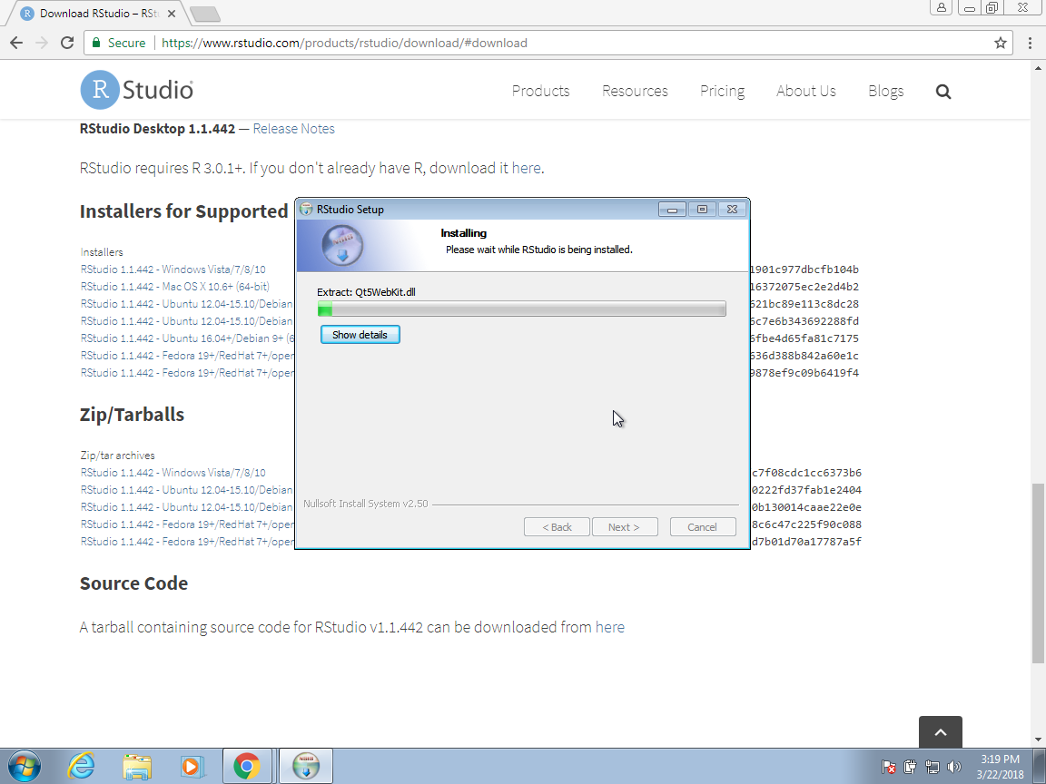

Slide 39
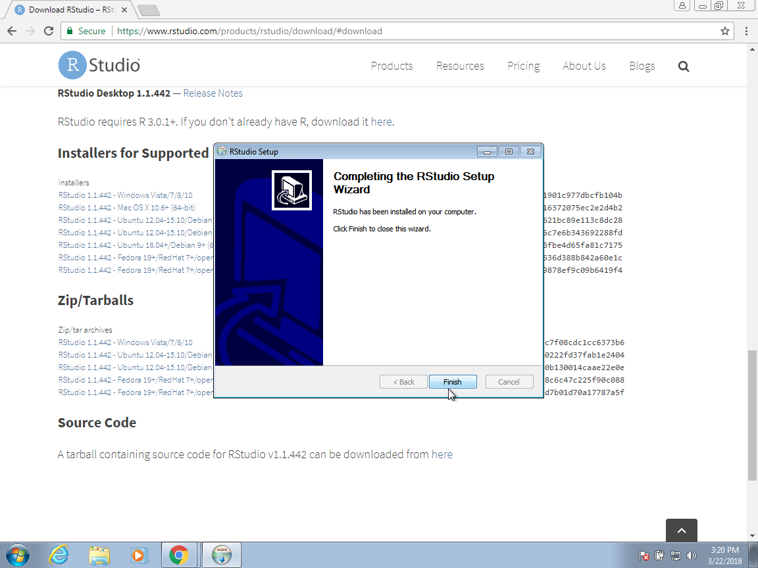

Slide 40
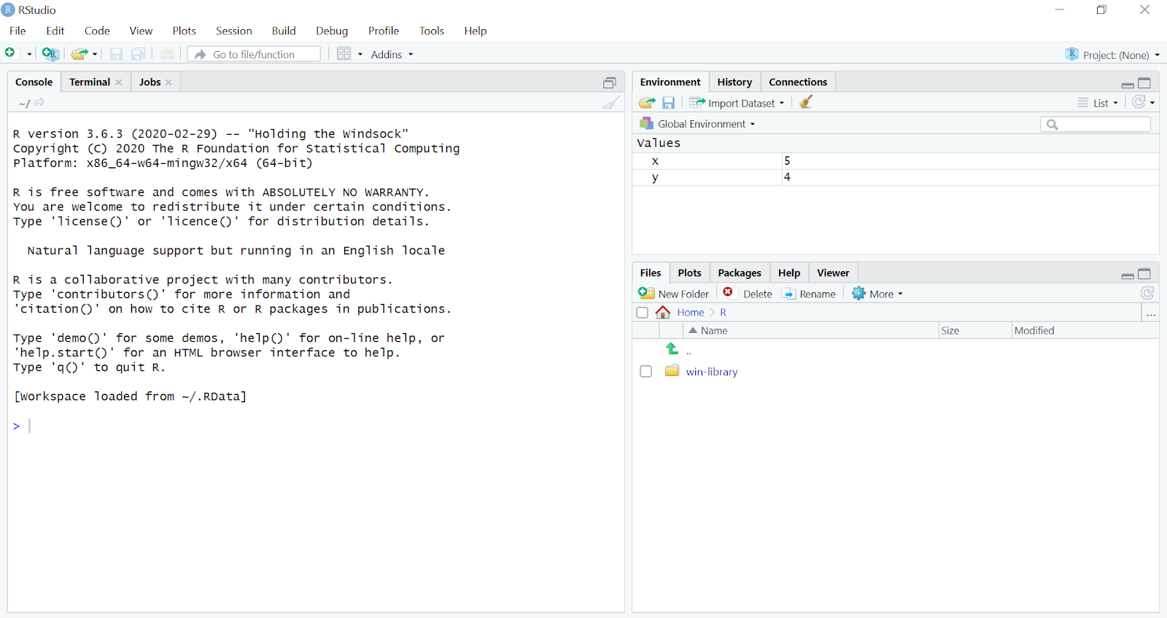

Slide 41
Assignment of variable
In R programming, there are three operators which we can use to assign the values to the variable.
<- leftward
-> rightward, and
= equal_to operator.

Slide 42
Basic Data Types

Slide 43
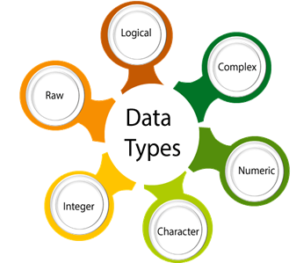

Slide 44
R has 6 basic data types.
Character ‘a’,”good”,’5’
numeric (real or decimal) ex: x=6.5,x=5
Integer ex: x=5L
Logical :true/false
Complex: ex 3+5i
Raw : holds the raw bytes

